Slide 1
Final Engagement
Attack, Defense & Analysis of a Vulnerable Network
Derek Anderson
Ryan Applegate
Marla Brannum
Cookie Gallardo
Alex Nelson

Slide 2
Table of Contents
This document contains the following resources:
Network Topology & Critical Vulnerabilities
Alerts Implemented
Hardening
Implementing Patches

Slide 3

Network Topology
& Critical Vulnerabilities
‹#›

Slide 4
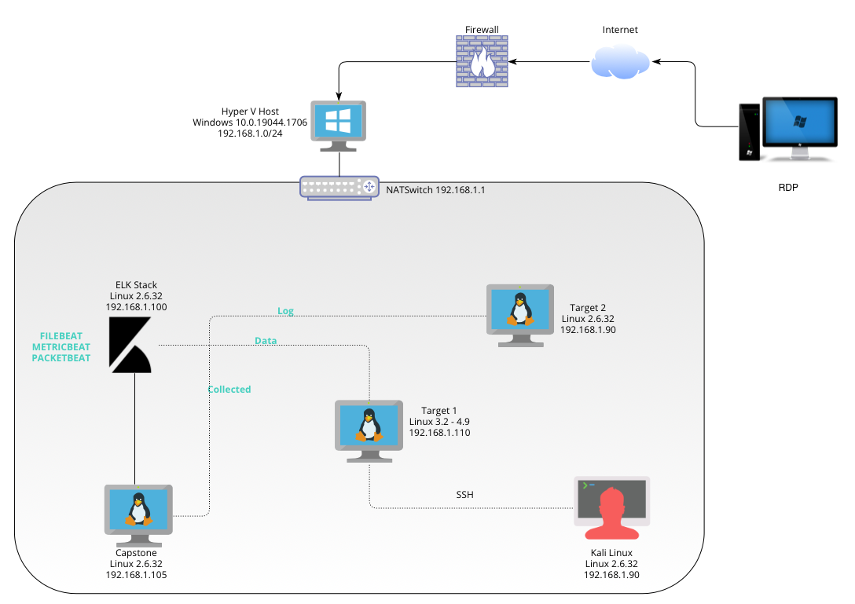
Network Topology
[Insert Here]
Use draw.io to create a diagram of the network.
Add your diagram to this slide and fill out the data in the sidebar.
Network
Address Range: 192.168.1.0/24
Netmask:255.255.255.0
Gateway: 192.168.1.1
Machines
IPv4:192.168.1.90
OS: Linux 2.6.32
Hostname: Kali
IPv4: 192.168.1.105
OS: Linux 2.6.32
Hostname: Capstone
IPv4:192.168.1.100
OS: Linux 2.6.32
Hostname: ELK
IPv4:192.168.1.1109
OS: Linus Linux 3.2-4.9
Hostname: Target1
IPv4: Target2
OS: Linux 2.6.32
Hostname: 192.168.1.115

Slide 5
Critical Vulnerabilities: Target 1
Our assessment uncovered the following critical vulnerabilities in Target 1.
Vulnerability | Description | Impact
Network Mapping | nmap | Discovers open ports 22, 80
MySQL Database access and exfiltration | Discovered file with login information | Gained access to MySQL database to exfiltrate password hash and crack with John the Ripper
WordPress Security | wpscan url | Gained username information
Weak Password | Guessed password, also used hydra | Gained access remotely and SSH into web server
User Privilege Escalation | User had python privileges | Used users python privilege to escalate to root

Slide 6
Alerts Implemented
‹#›

Slide 7
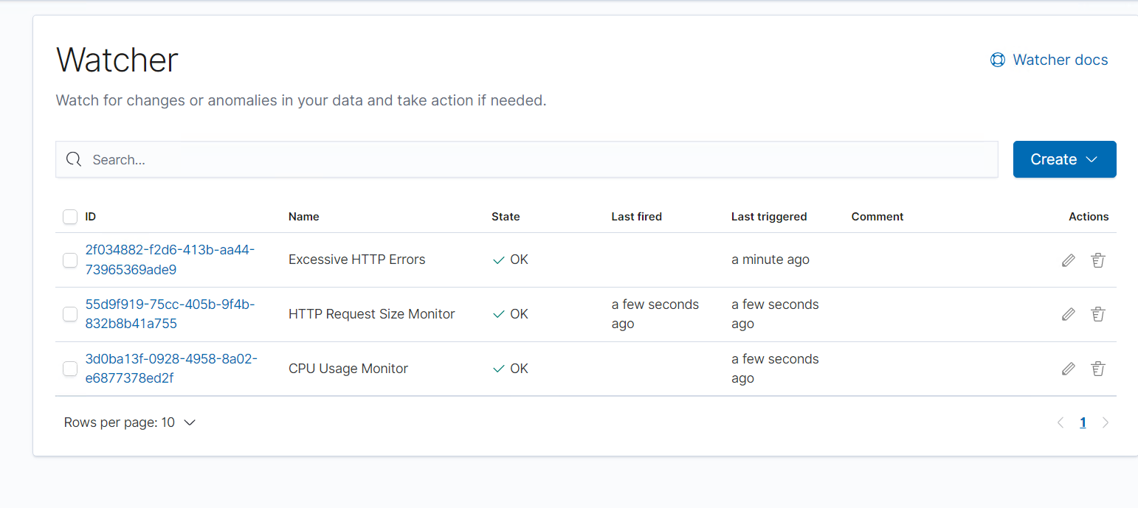
Watcher

Slide 8
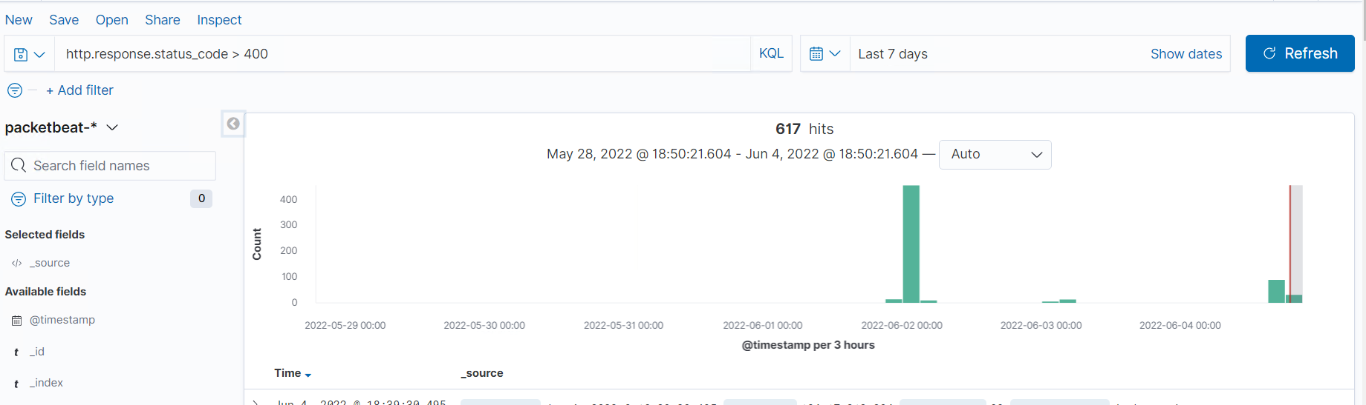
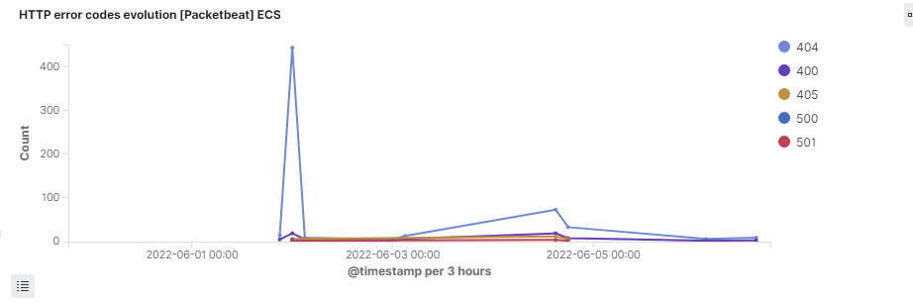
Excessive HTTP Errors
Metric: When the Count() Grouped over top 5 “http.response.status_code’
This watches for status code responses and an alert is triggered with the threshold listed below. This is used to mitigate enumeration and brute force.
Threshold: Is above 400 in the last 5 minutes.
Below is a screenshot of the Alert in action.

Slide 9
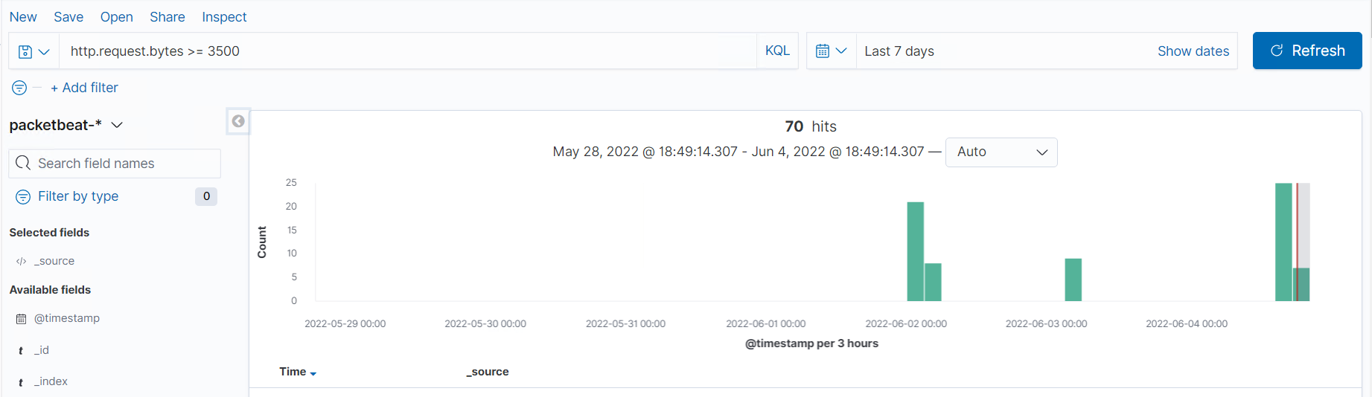
HTTP Request Size Monitor
Metric: When sum() of http.request.bytes OVER all documents
This alert using packetbeat monitors HTTP data requests, an alert is triggered when the threshold below is reached. This alert is to mitigate Denial of Service Attacks as well as Malicious software uploading.
Threshold: Above 3500
Below is a screenshot of the Alert in action.

Slide 10
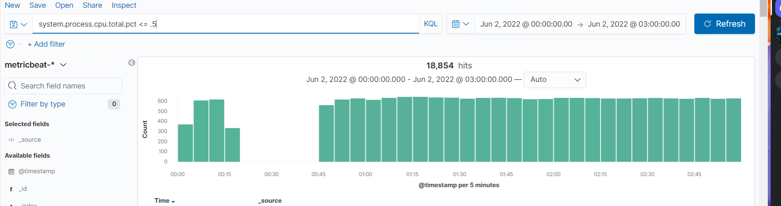
CPU Usage Monitor
Metric: When max() Of system.process.cpu.total.pct OVER all documents
This alert using metricbeat watches for the percentage of CPU activity and if it crosses the threshold listed below an alert is triggered. This alert is used to mitigate malicious software, and resource management. Syn Ack Floods.
Threshold: Above .5
Below is a screen shot of the Alert in action.

Slide 11
Hardening
‹#›

Slide 12
Hardening Against Network Mapping on Target 1
How to Patch
Make sure software and operating system is kept up to date
Use a firewall to block unwanted traffic before it enters the system
Segment open ports 22 and 80 into a DMZ, a Demilitarized Zone
Why this Works
Software and operating system updates will make sure any patches will be installed and the system will be up to date with the latest security protocols
A firewall will limit traffic to the system and keep any traffic that is designated as dangerous or unwanted out, thus protecting valuable data and info
Segmenting the open ports to a DMZ will make sure that if there is any malicious activity that makes it into any open ports, it will be kept separate from the rest of the network and minimizing damage.

Slide 13
Hardening Against MySQL Database Access on Target 1
How to Patch
Keep database and web servers separate
Put database behind its own firewall
Regularly update operating system and patches
Use parameterized queries
Why this Works
Keeping the database and web servers separates allows your data to be protected and safe if there is an attack on the web server
Putting the database behind its own firewall will add extra protection against unwanted traffic. It allows only traffic allowable by the system administrator, usually very few people will have access to the actually database server.
Making sure your operating system is up to date and any patches is installed will give you the most up to date protection against any known vulnerabilities
A parameterized query is when a placeholder is used for parameters and the values are supplied at the time of execution. It prevents SQL injection attacks by making sure certain data is allowed to be asked for in a query.

Slide 14
Hardening Against Wordpress Security on Target 1
How to Patch
Limit use of plugins and make sure Wordpress and plugins are up to date
Use secure passwords and salt hashes
Make sure the wp-config.php and wp-login.php files are not accessible to the public
Why this Works
Using additional software that is not necessary increases the number of potential vulnerabilities. Recent Wordpress patches have fixed many of the security flaws found in earlier versions.
How to Configure
Restrict the WordPress REST API
Disable WordPress XML-RPC
Configure Wordpress to block requests to /?author=<number>

Slide 15
Hardening Against Weak Passwords on Target 1
How to Patch
Create a password policy that specifies password length, special characters, and password must be changed frequently. "Michael" is not a strong password
Password hashes should be salted to make them more difficult to crack Why this Works
Strong password rules and salting hashes prevents password guessing and brute force attacks
How to Configure
To generate a cryptographically strong hash, utilities such as bcrypt and SecureRandom can be used

Slide 16
Hardening Against Privilege Escalation on Target 1
How to Patch
Concept of least privilege should be followed for all users so they cannot escalate privileges or access files they don't need to access
Enforce password policy to ensure low level accounts can't be accessed to gain access to higher level accounts
Review all accounts to see if there are any accounts with administrator access that don't need it
Why this Works
Setting and reviewing permissions and roles limits a hacker's ability to escalate privileges
How to Configure
Use "auditd" to monitor file access
Remove sudo access for python from the user
Properly configure sudoers file to limit who has root access

Slide 17
Implementing Patches
‹#›

Slide 18
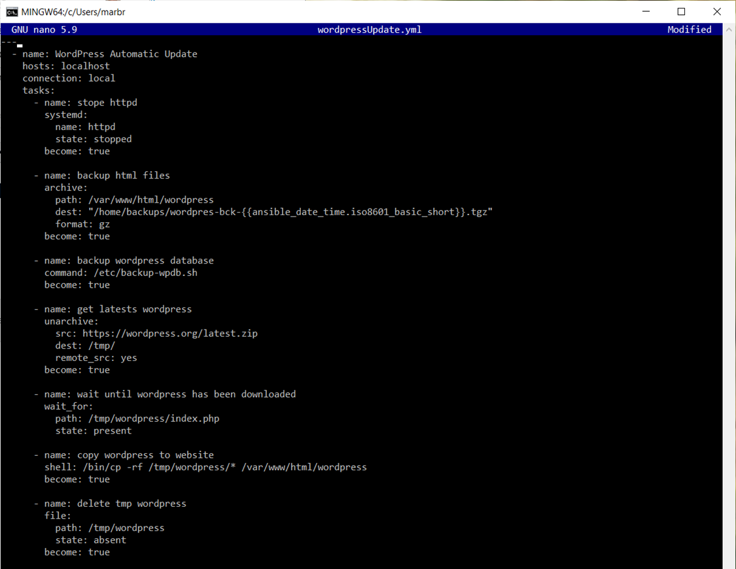
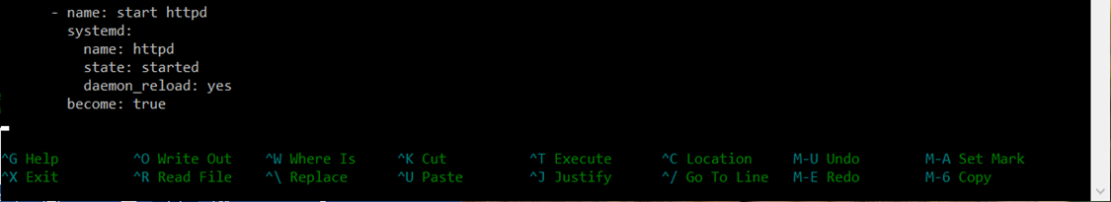
Implementing Patches with Ansible
Set Up Automatic Updates for WordPress
Setting up automatic updates ensures being up-to-date on current patches.
Script covers backing up WordPress, downloading most current version, copy to website and deleting the tmp file created.
Command to run the script is: sudo ansible-playbook -v wordpressUpdate.yml
yml script credit goes to petersplanet.nl (there was no need to re-create the wheel)

Slide 19
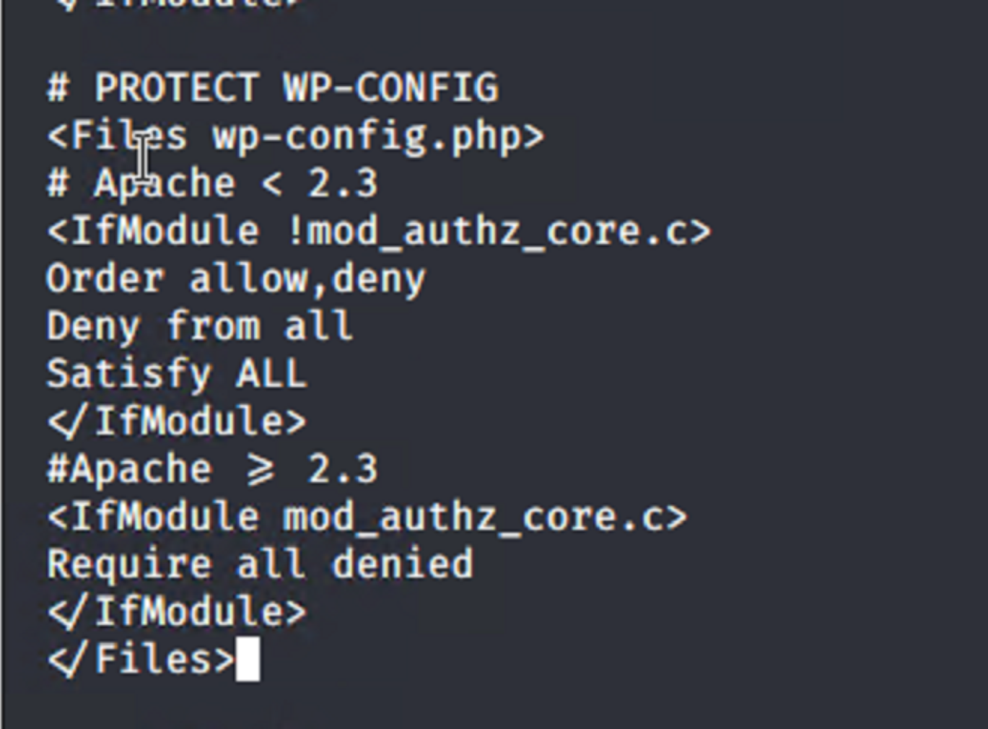
Implementing Patches with Linux
Overview
Restrict access to the wp-config.php file using .htaccess
Use the code ⇒
Save and upload to the server
This protects the file from being read in plaintext
Code is from amberdesign.com

Slide 20
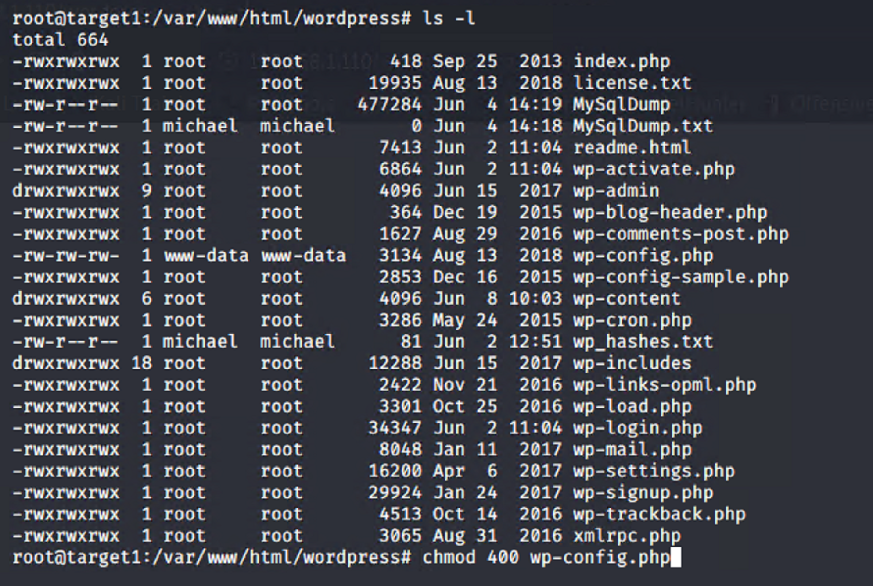
Implementing Patches with Linux
Overview
Change file permissions for the wp-config.php to 400, with read
Command:
chmod 400 wp-config.php

